Slide 1
APEC Training Workshop on Solar Technology Application
Asian Development Institute for Community Economy and Technology
Community DC-AC Microgrid
Hathaithip Sintuya
Training on Renewable Energy Policy Tools and Energy Technologies Best Practice
adiCET, Chiang Mai, Thailand
November 22, 2018

Slide 2
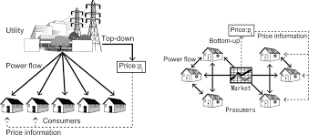
Smart Cities Driven by Energy 4.0
Digital Society
①
(Digital Disruption)
Low Carbon
②
(Decarbonized)
User Changes Producer
③
(Prosumer)

Slide 4
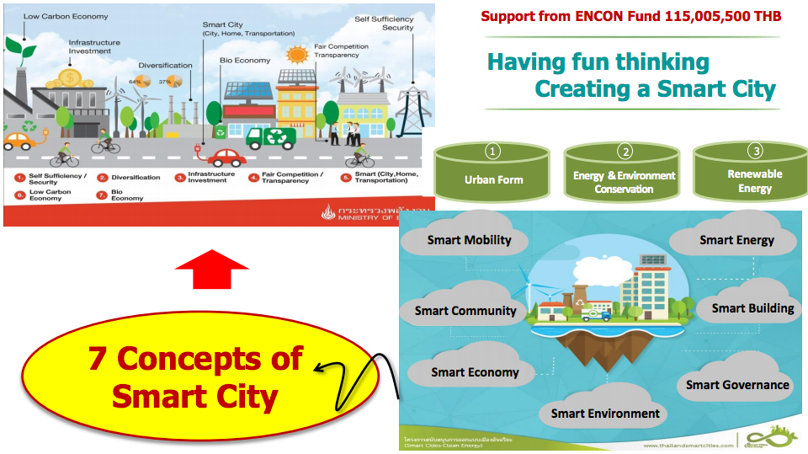
Thailand Smart Cities
Thailand Smart Cities

Slide 5
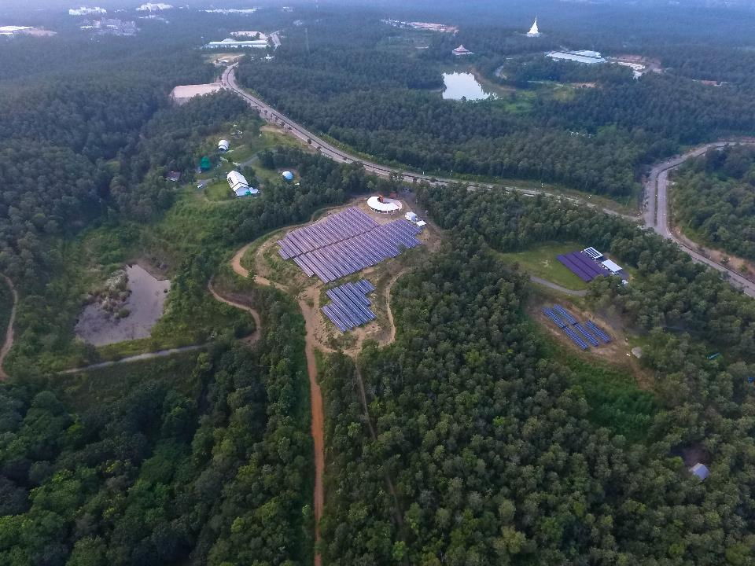
adiCET, CMRU

Slide 6
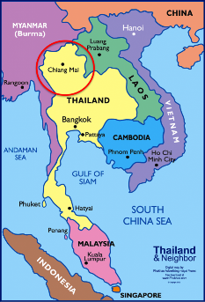
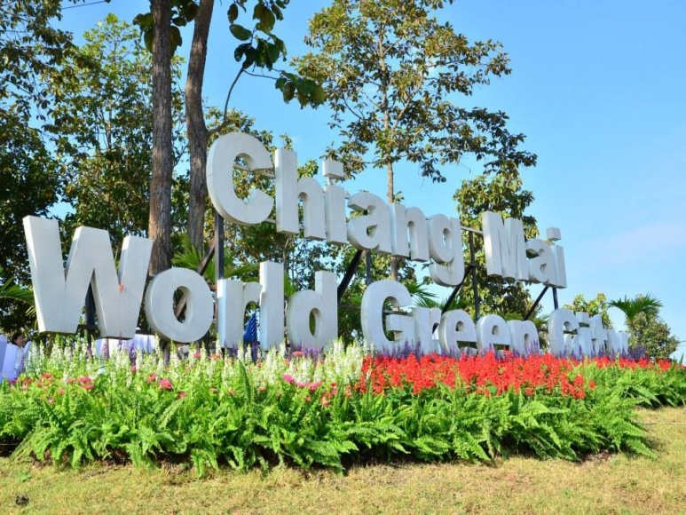
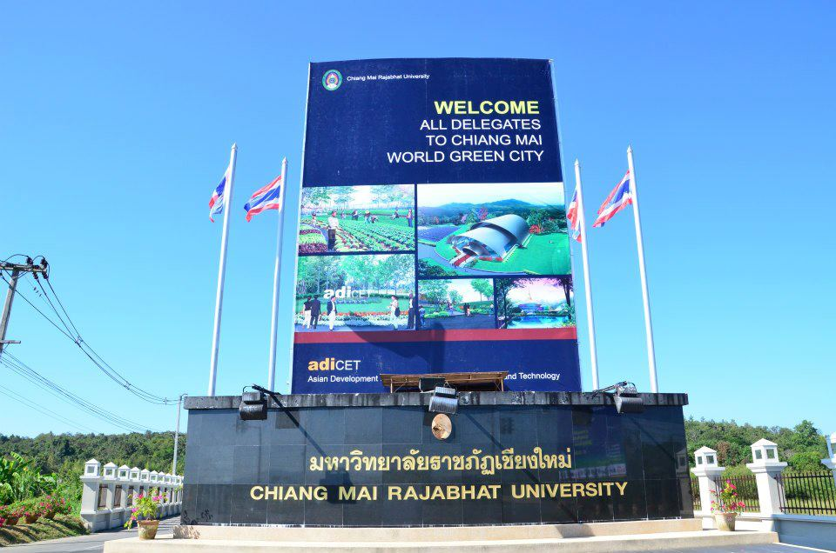
adiCET, Chiang Mai Rajabhat University (CMRU)
Academic – R&D – Training institution for the well-being of the community by using green technologies.
Graduate Program in Community Economy and Technology
Model Community with green technologies and renewable energy
Hybrid System – Smart Community Microgrid

Slide 7
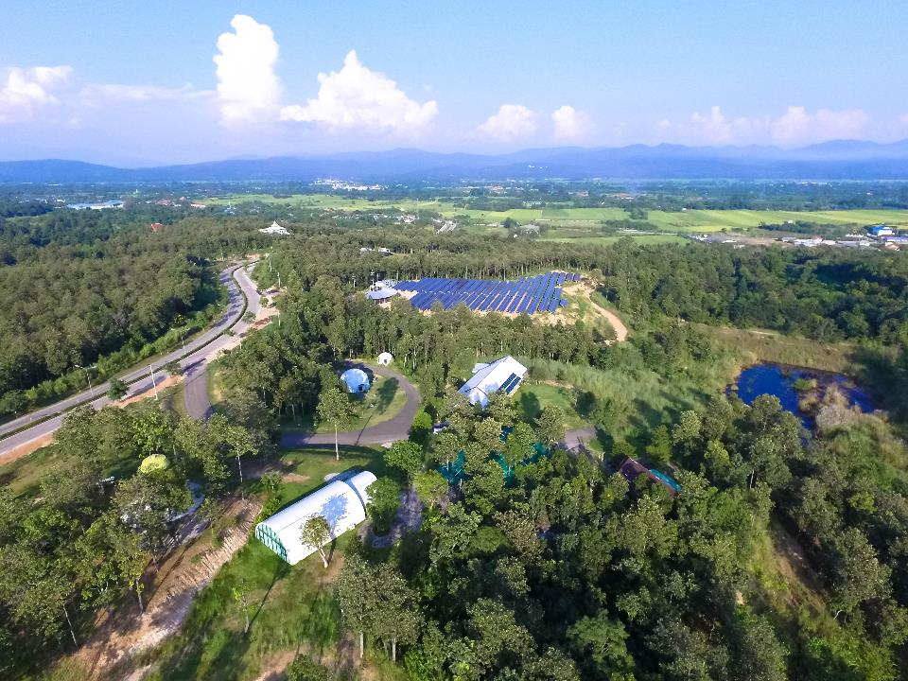
Renewable Energy & Green Technology Integration for
Local Community Development

Slide 8
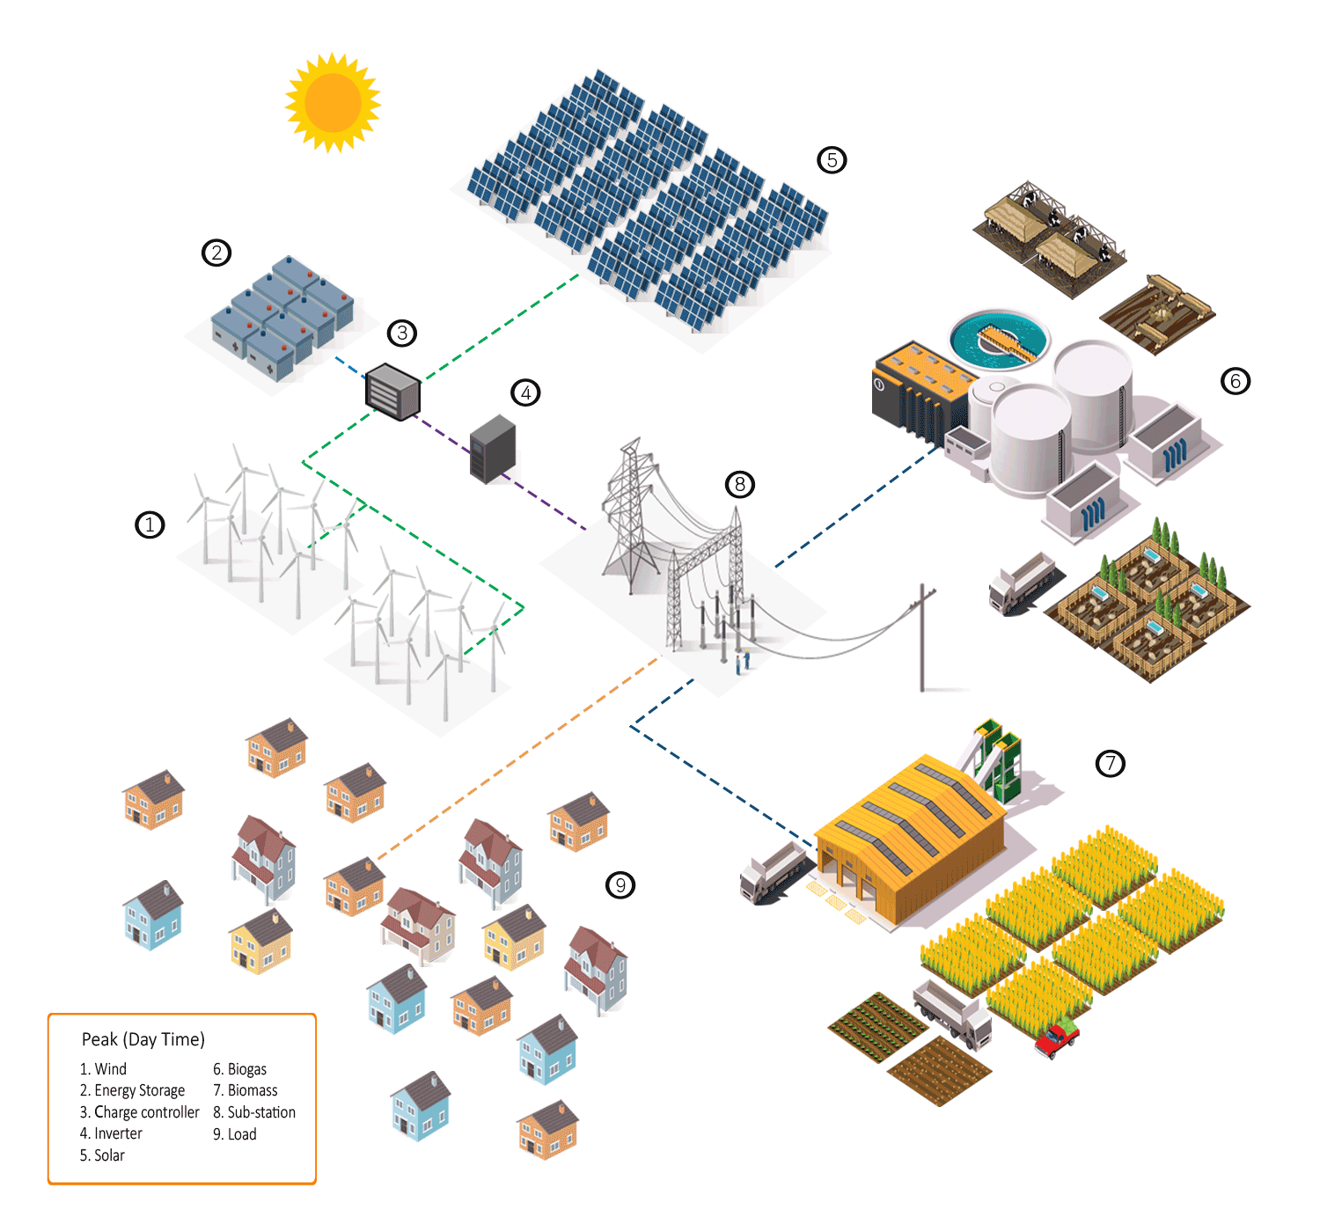
SPP Hybrid Demo Site
Smart Community Training Center
Green Technology Living Laboratory
Goal
Notes:
This is how the power is distributed to the houses

Slide 9
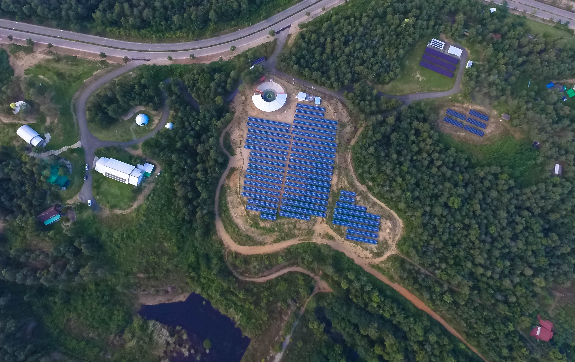
10 New Smart Homes
Green Business
DC & AC Microgrid
Smart Farm
Grid Connected
Energy Storage
Energy Efficiency
Bioenergy
Chiang Mai World Green City: Real Living Learning Park
Notes:
Now I would like to explain about the Zone A which is the smart community –The smart community uses 100% renewable energy and strive to be sustainable community. Students & staff of adiCET lived here. We also opened many houses to the general public to experience the sustainable way of living.

Slide 10
Community DC-AC Microgrid adiCET, CMRU

Slide 11
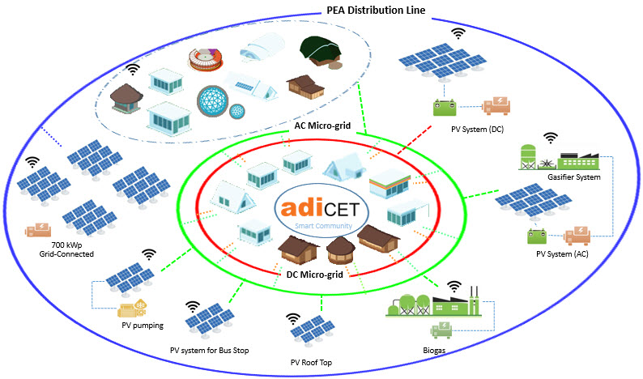
Community DC-AC power system
Chiang Mai World Green City (CWGC) model

Slide 12
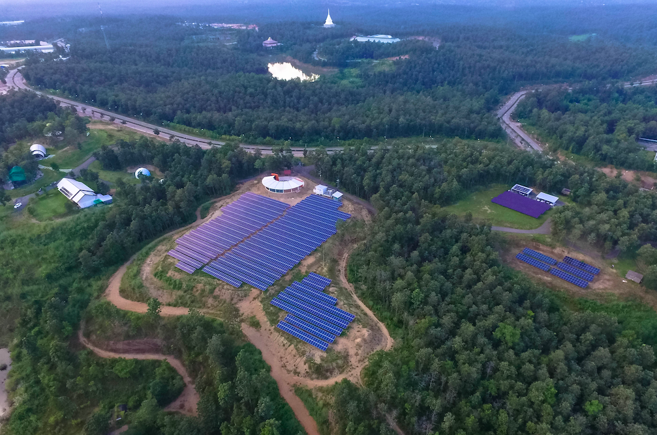
PV Systems ~ 762 kWp
2.64 kW Stand Alone
EV Charging Station
25.5 kW DC Microgrid
Off Grid
3 kW
Water
Pumping
3.5 kW Rooftop
25 kW AC Microgrid
Grid Connected
702 kW
Grid Connected

Slide 13
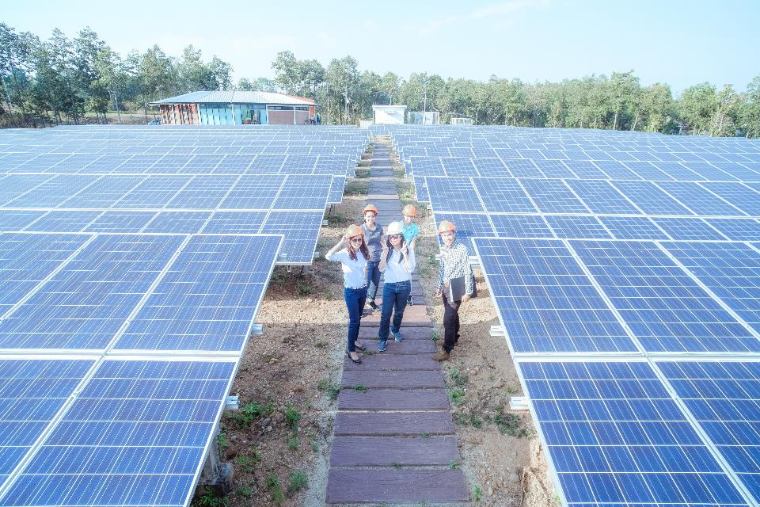
702 kW - Grid Connected

Slide 14
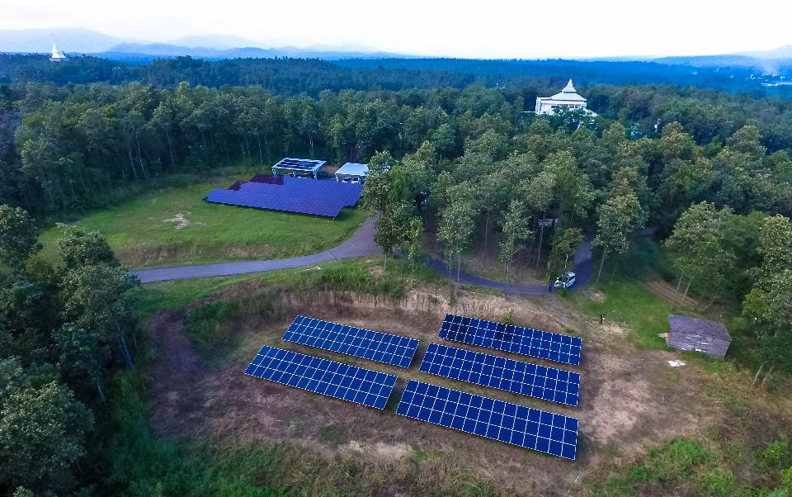
25 kW DC Off-Grid & 25 kW AC Grid Connected

Slide 15
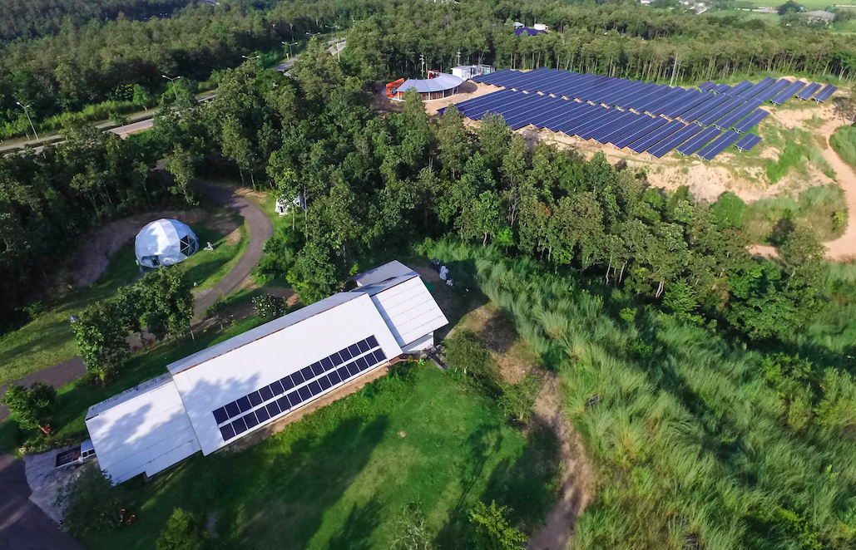
3.5 kW Rooftop Grid Connected

Slide 16
Community
Product
Community
Business
DC Home
Green Resort
Community
Restaurant
PV Stand Alone
DC Microgrid
Recycle Road
Household
Biogas
Community Power Training Center
Biodiesel Generator
Exhibition Center
Energy Efficient Building
Solar Pumping
AC Microgrid
Biogas
Low Carbon
Agriculture
Biomass
Gasifier
Natural Material Building
Smart Water System
PV Grid Connected
Community Solar Farms
Energy
Crop
Hydroponics
Fertilizer Organic wastes
Wood chip
Wood pellet
Chiang Mai World Green City: Real Living Learning Park
Notes:
องค์ประกอบของ Chiang Mai World Green City เกิดมาจาก งานวิจัยและบริการวิชาการกว่า 50 โครงการ

Slide 17
Scope of DC Community
Living Laboratory for community transition from AC → AC/DC → DC Community
Evaluate Low Cost - Low Voltage DC Community Power System at the Smart Community
Phase 1: Lightings 24 VDC/ 1 House 240 VDC
Phase 2: Household Appliances 260-297 VDC
Modify/Testing Household Appliances for DC & AC usage
Lighting, Refrigerator, Air Conditioner, Water Heater, Television, Computer, Rice Cooker, Microwave, Washing Machine
Evaluate appliances during operation, stability and safety
Full DC
Full AC
Mixed DC & AC
Notes:
ขอบเขตของงานวิจัยนี้ คือ
ทดสอบภาระทางไฟฟ้าด้วยโครงข่ายไฟฟ้ากระแสตรงแรงดันต่ำ ที่วิทยาลัยพัฒนาเศรษฐกิจและเทคโนโลยีชุมชน
2. ดัดแปลงปรับปรุงภาระทางไฟฟ้าต่าง ๆ ให้สามารถใช้ไฟฟ้ากระแสตรงได้ โดยภาระทางไฟฟ้าที่ระบบเซลล์แสงอาทิตย์ที่พัฒนาขึ้นประกอบด้วย หลอดไฟ ตู้เย็น เครื่องปรับอากาศ เครื่องทำน้ำร้อน และโทรทัศน์
3. ทดสอบสมรรถนะทางด้านเทคนิค ความเสถียรภาพ และความปลอดภัยของภาระทางไฟฟ้า

Slide 18
PV AC vs. PV DC
DC
DC
AC
AC Load
PV Array
Charge Controller
Inverter
DC
DC Load
Battery
PV Array
DC
Charge Controller
DC
DC Load
DC
Higher system efficiency by eliminating DC/AC/DC conversion
Lower cost from eliminating inverter
Battery

Slide 19
System Design and Installation
PV Array
25.5 kWp
DC,
323 V
80 A (Max)
Charge Controller
DC, 323 V 80 A (Max)
1st Phase
Battery
105.6kWp
Converter
to 24 VDC
DC
24 V
600 W
DC Load
Lighting
DC, 264-297 V
2nd Phase
DC Load
Notes:
ภาพนี้แสดงการออกแบบระบบโรงไฟฟ้าที่ติดตั้ง เพื่อทำการทดสอบการไฟฟ้ากระแสตรง 264V
ซึ่งออกแบบระบบโซล่าเซลล์ให้มีขนาด 25.5 kW เป็นแหล่งผลิตไฟฟ้า
ชาร์เจอร์เป็นอุปกรณ์ช่วยควบคุมการประจุแบตเตอรี่ส่งถ่ายไฟฟ้าไปยังโหลด

Slide 20
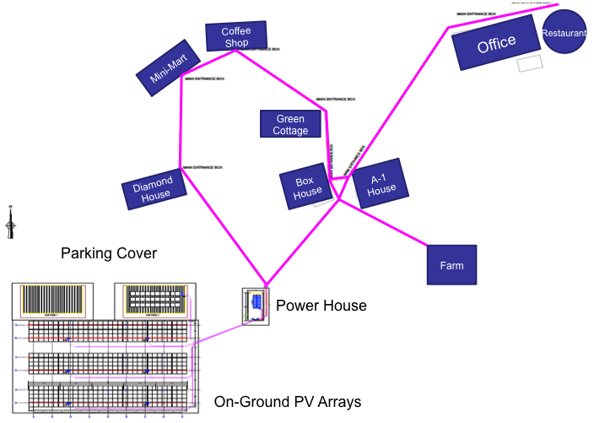
DC Microgrid
Load:
1 office, 1 minimart,
1 restaurant,
1 coffee shop,
1 farm, 4 houses
Battery: 105.6 kW
Utility & 25 kW
AC Microgrid
Diesel Generator 40kW
25.5 kW
Notes:
The power cables are underground to each of the building

Slide 21
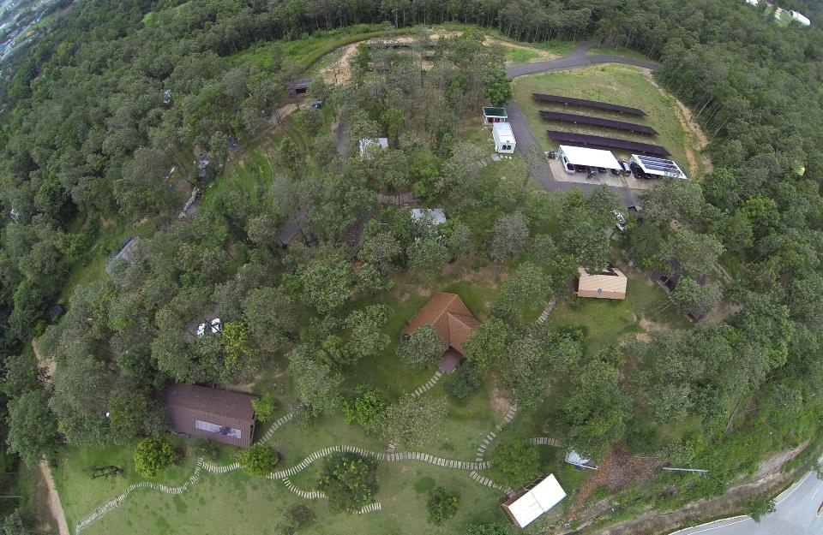
Smart Community – AC/DC Smart Grid
Biomass Gasifier
AC PV System
DC PV System
Biodiesel
Generator
Biogas
Home
Smart Farm
Home
Home
Home
Home
Home
Load:
1 office
1 minimart,
1 restaurant
1 coffee shop
1 farm
6 houses
Restaurant
Minimart
Office
Coffee Shop

Slide 22
Biodiesel Generator
40 kW
PV DC Microgrid
25.5 kW
Biomass Gasifier
20 kW
PV AC Microgrid
25 kW

Slide 23
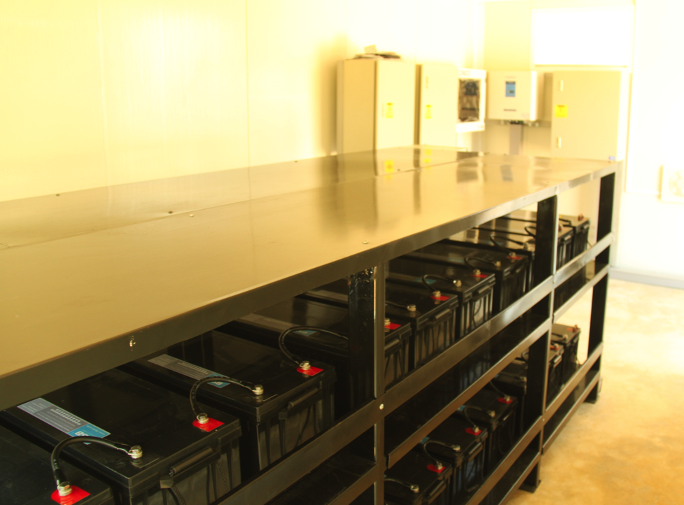
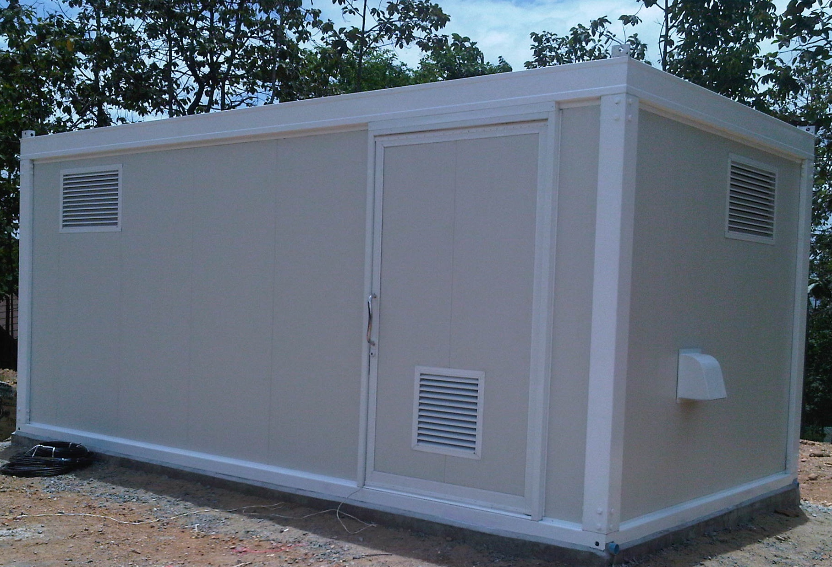
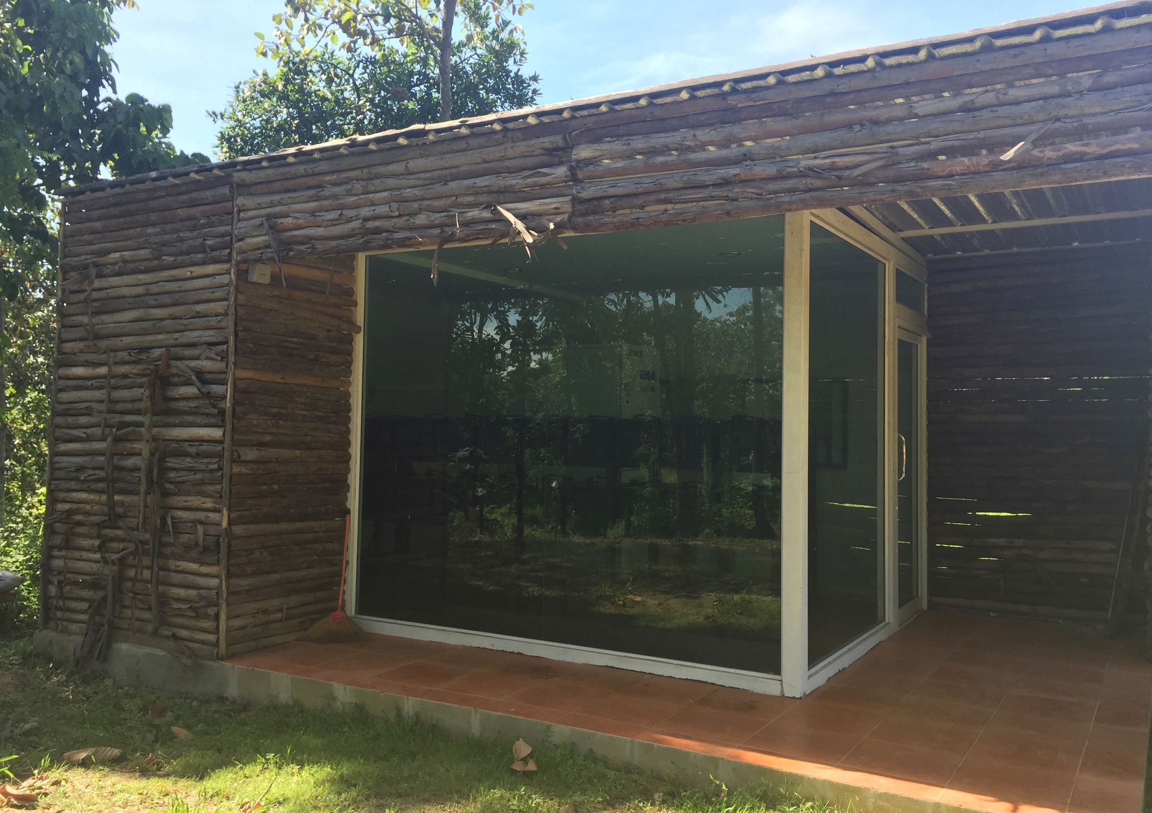
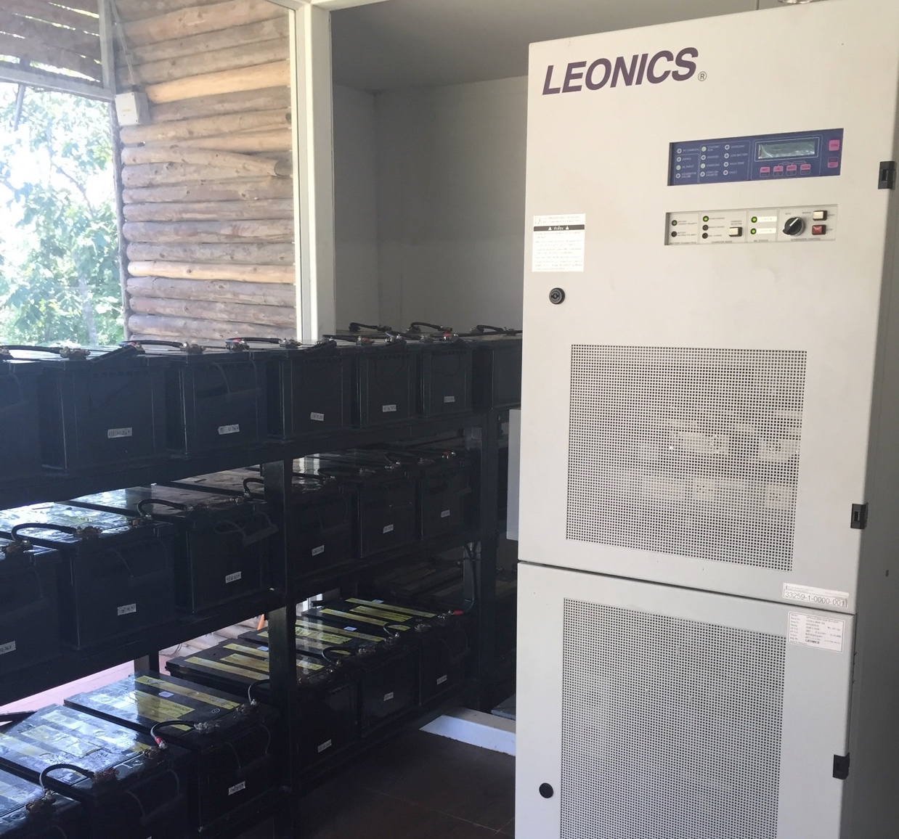
Off-grid: PV DC Microgrid Battery Bank (~100 kWh)
Backup power/ Power Control and Stability
Battery House
On-grid: PV AC Microgrid Battery Bank (~100 kWh)
Backup power/ Power Control and Stability

Slide 24
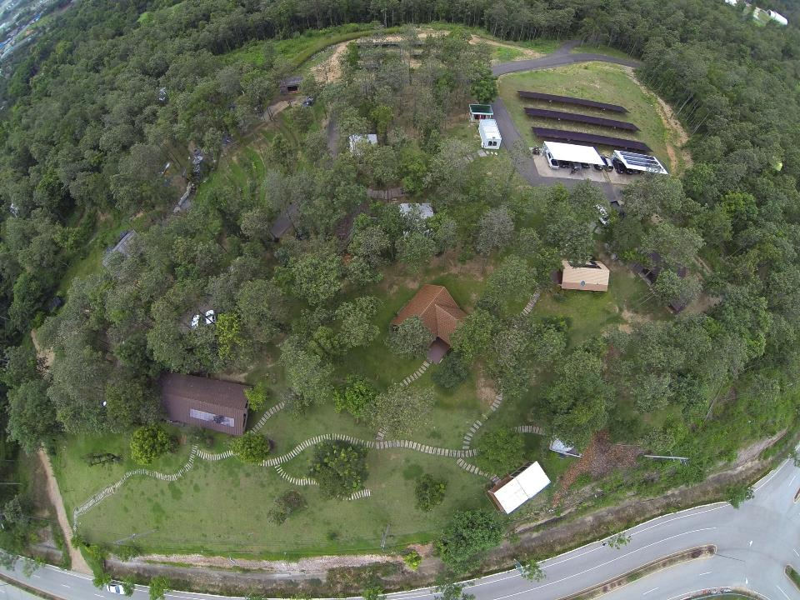
Convert All Electrical Devices to DC Usage
Install Power Supply Controller
Install Booster Battery

Slide 25
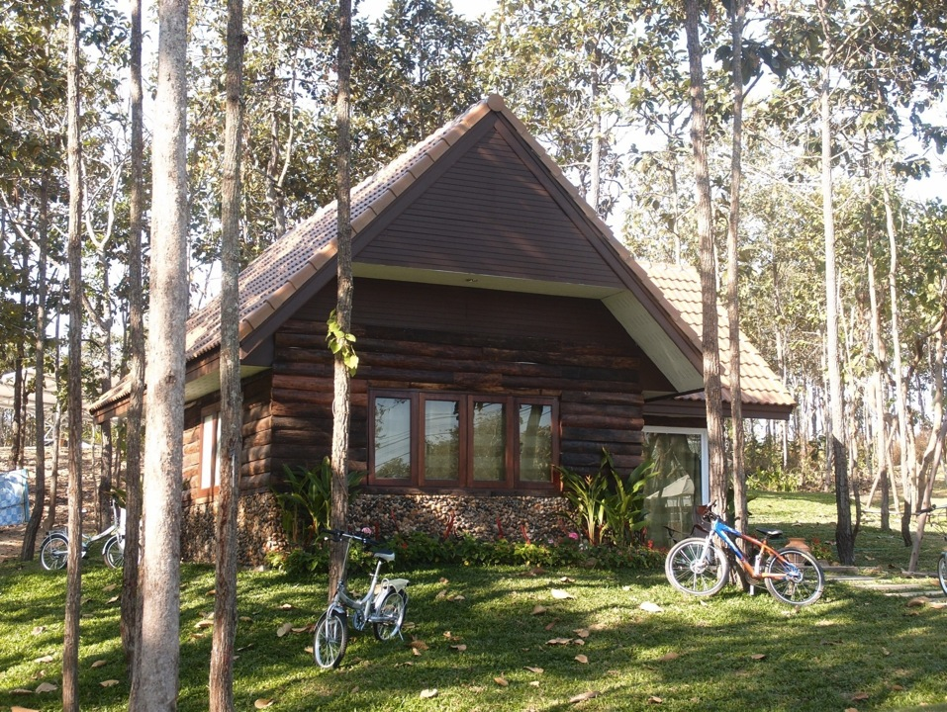
Notes:
Each building has a converter box for the DC conversion.

Slide 26
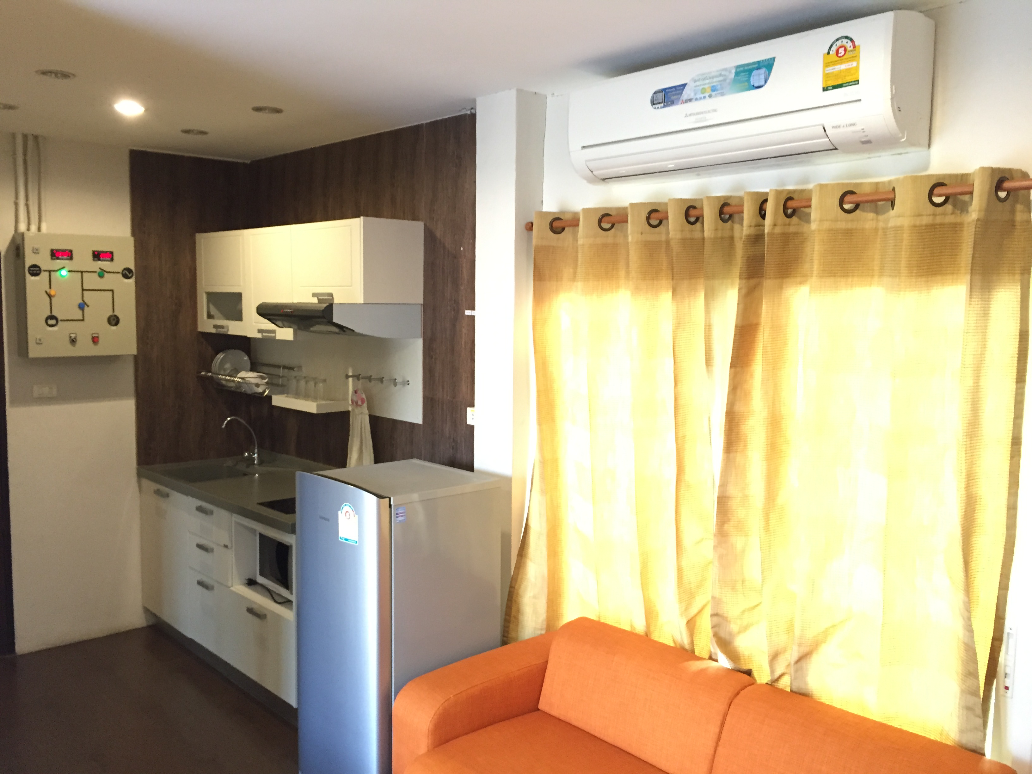
Home energy monitoring system
DC & AC Smart plug

Slide 27
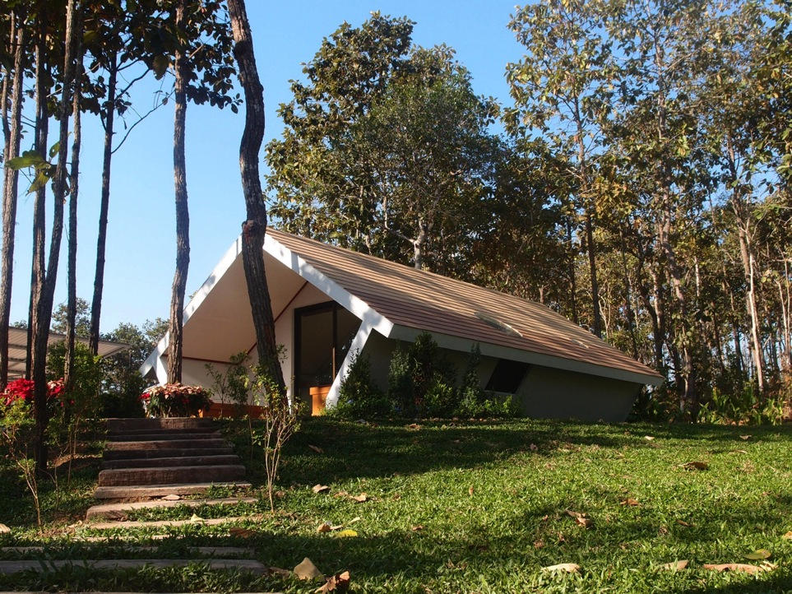
Home monitoring system: Temp, Humidity, Wind Speed
Expanded Polystyrene Foam
Notes:
This house is from EPS foam. All the interior is made out of foam as well.

Slide 28
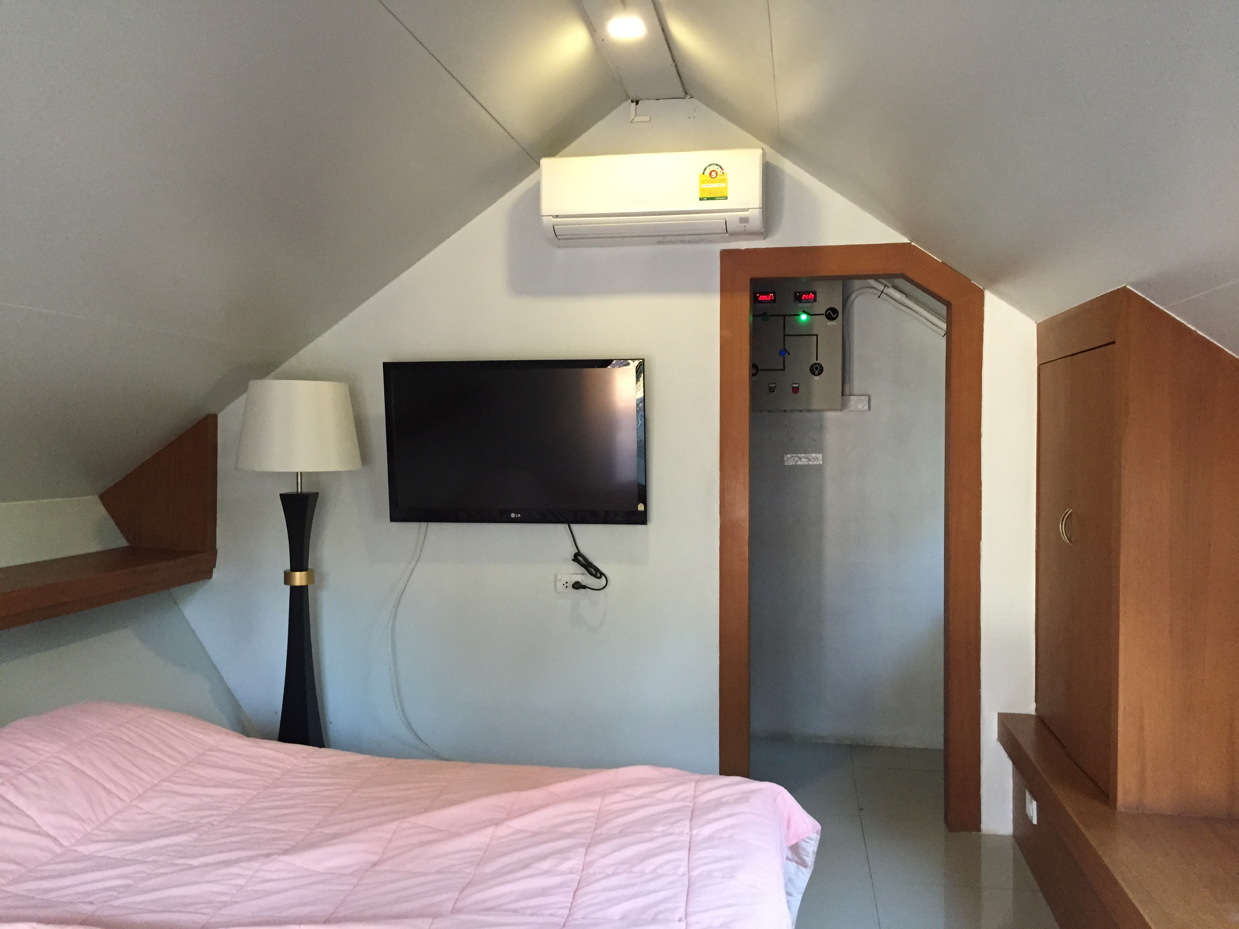
Home monitoring system: Temp, Humidity, Wind Speed

Slide 29
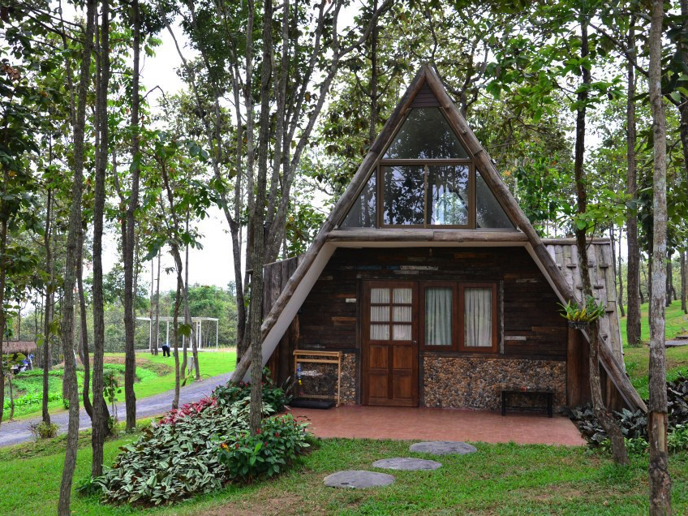
Reuse material house

Slide 30
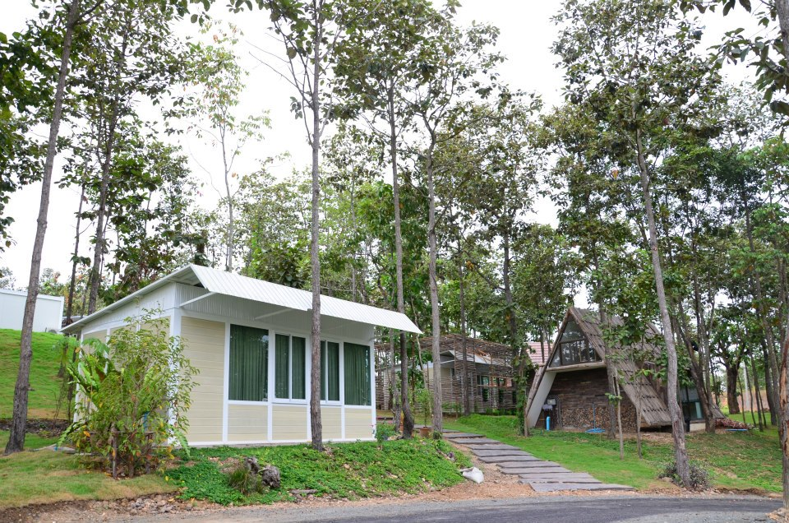
Insulation
Construction material for hot & humid climate
Resident

Slide 31
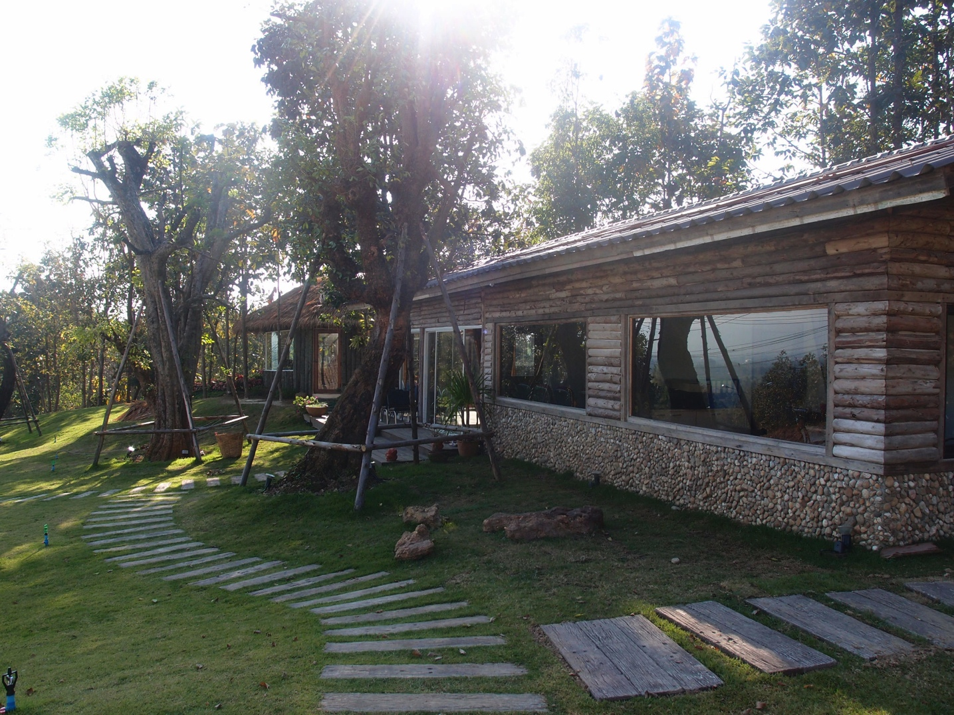
Office

Slide 32
Power Supply Controller
Central Battery Bank – DC
AC – Utility
AC Microgrid
DC
Battery
Load
DC – AC
Switch
Alarm

Slide 33
Operation Mode
Mode | Central Battery Voltage Stage | Usage
Full | 297 – 260 VDC | DC use directly from Central Battery bank
Battery Boosting | 260 – 250 VDC | DC from Battery bank (260 VDC) & Booster (54 VDC)
Biodiesel Generator Start | 250 – 242 VDC | Generator Charge Battery Bank Charge Booster Batteries If ran out of fuel, AC from Utility will convert to DC
Battery dead | Below 242 VDC | Automatically switch to AC
Note: Voltage range depends on Charger Specification, battery voltage range and electrical load device requirements.

Slide 34
Experimental Setup Hybrid DC Microgrid
297 – 260 VDC – CB
260 – 250 VDC – CB + BB
250 – 242 VDC – Gen

Slide 35
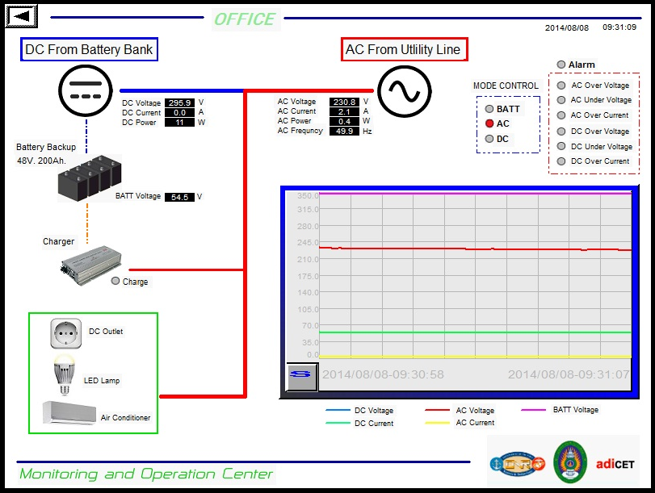
Data Monitoring

Slide 36
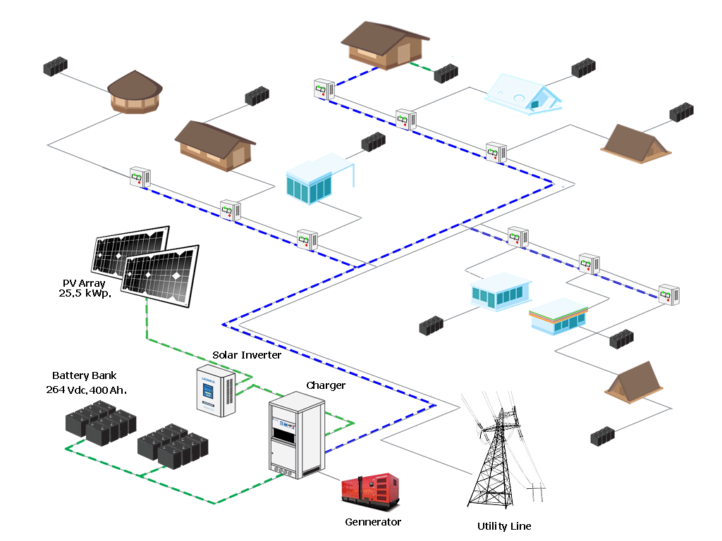
Normal Operation + Battery Boost

Slide 37
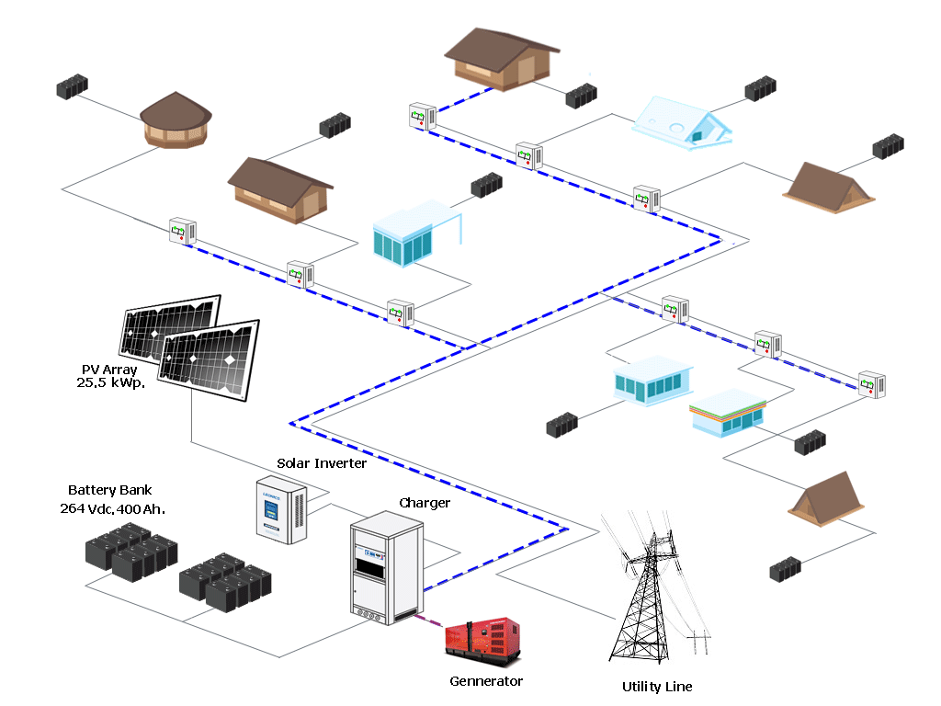
Diesel Generator Mode

Slide 38
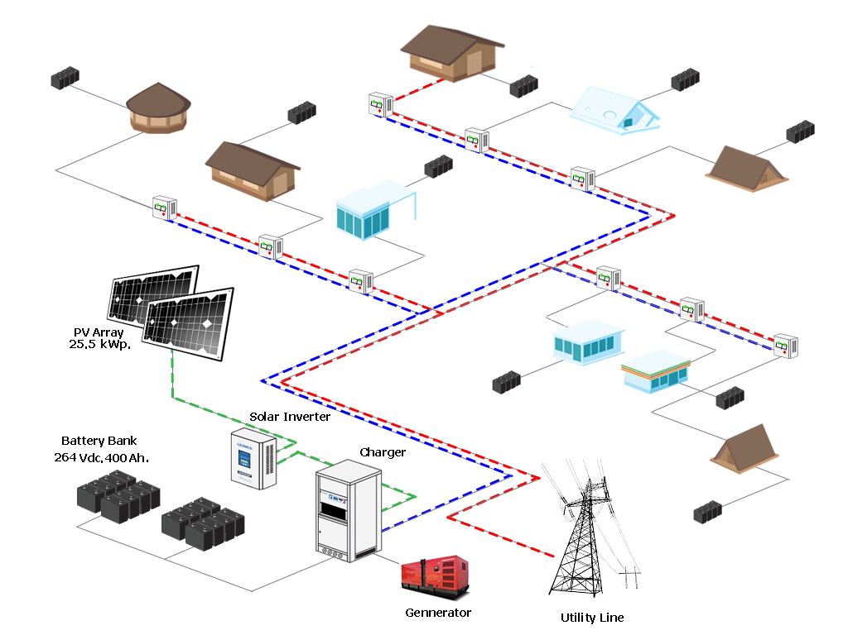
DC and AC Selection

Slide 39
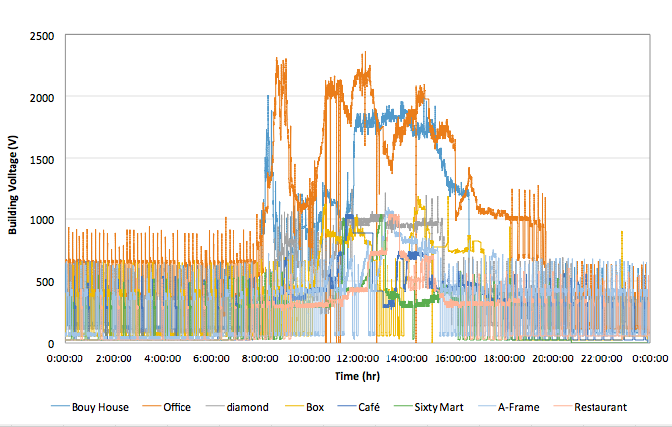
Building Power Consumption
Building Energy Consumption (W)

Slide 40
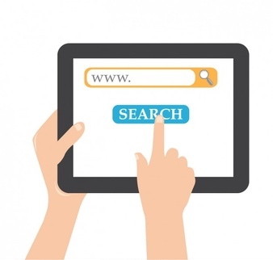
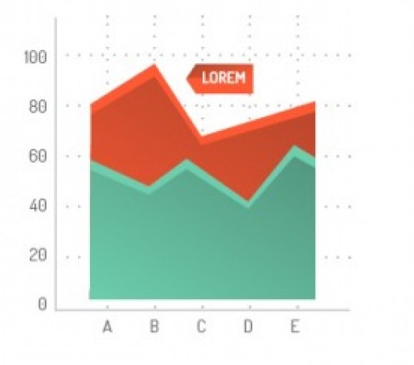
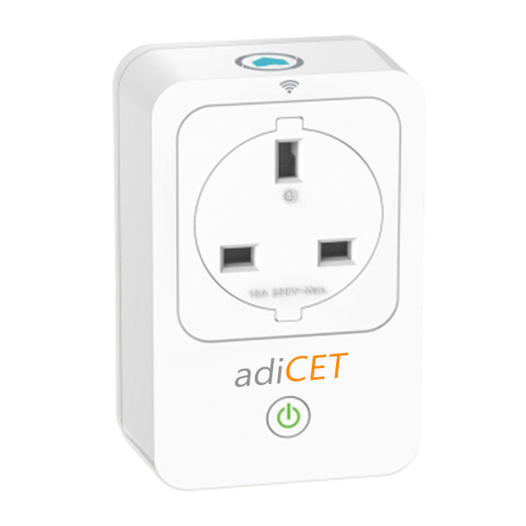
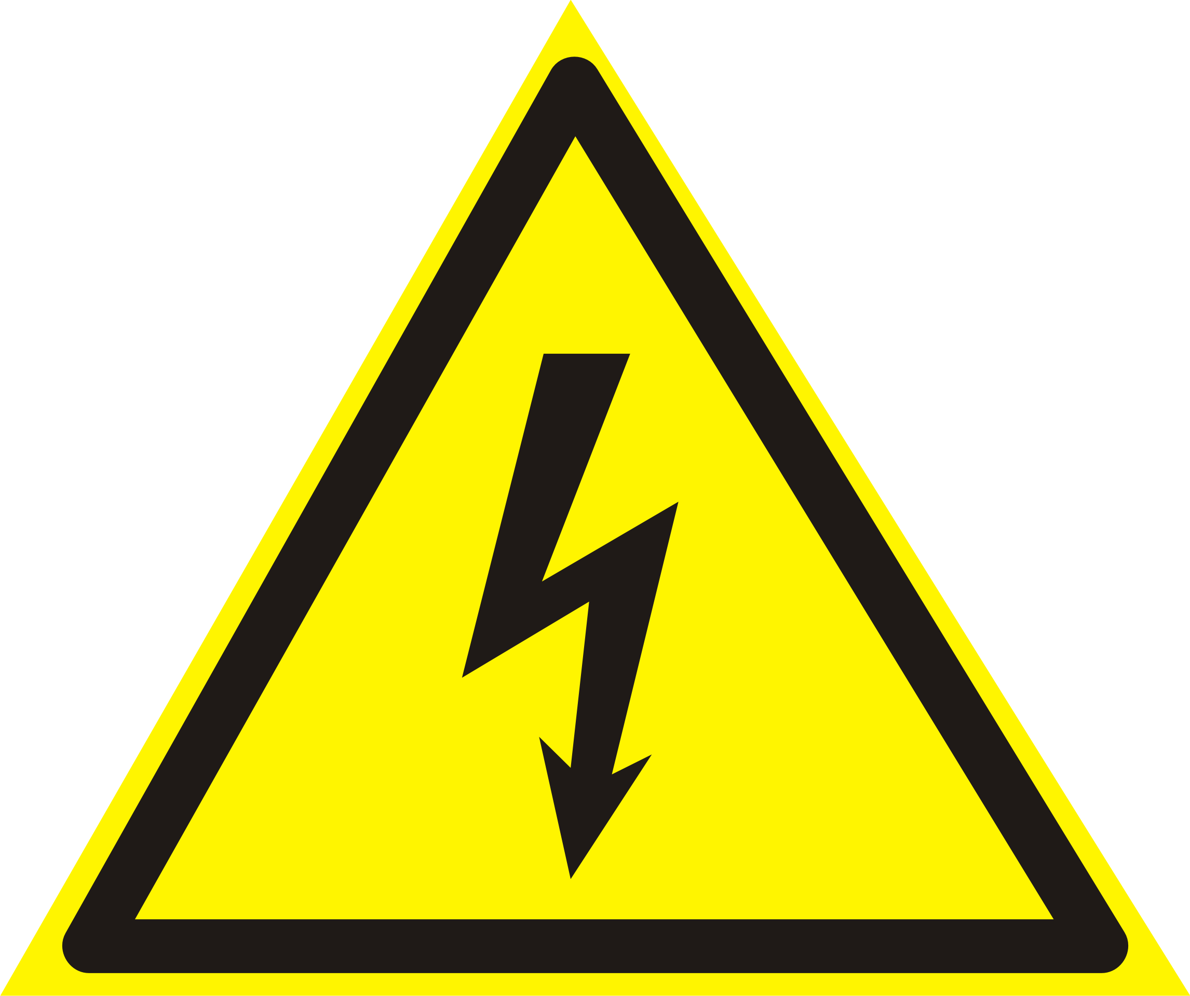
adiCET DC Smart Plug
Online Function
Measurement Function
Web and Application
Power consumption
Behavior
Controls
Monitors
Program
Smart Function
Safety
Smart Connection
Smart Data Collection
Energy saving
Prototype for DC Smart Plug
N. Songkittirote – M.S.
Notes:
Now, we are developing the DC Smart Plug to control the appliances in the house

Slide 41
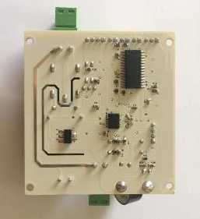
adiCET DC SmartHome

Slide 42
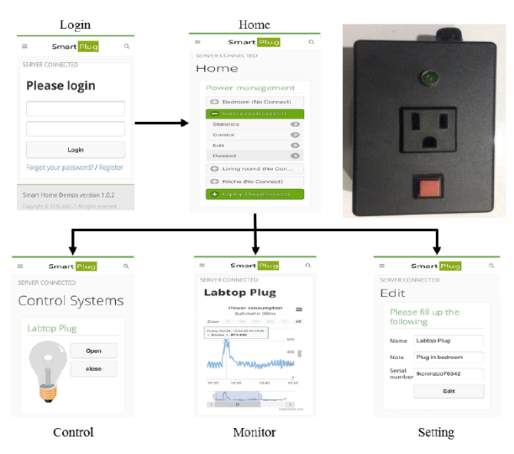
adiCET DC Smart Plug Prototype

Slide 43
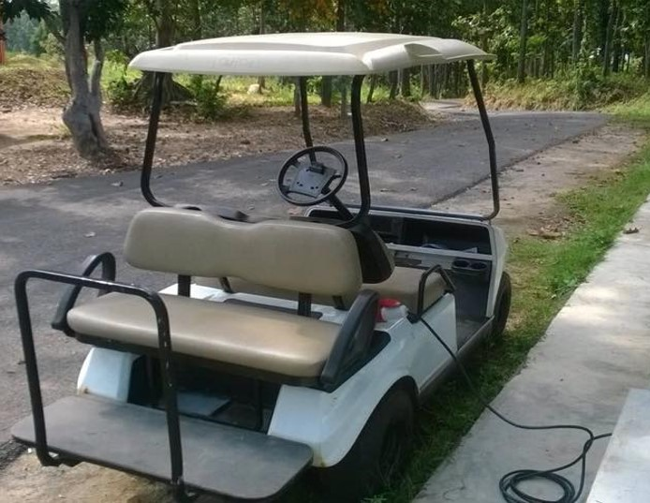
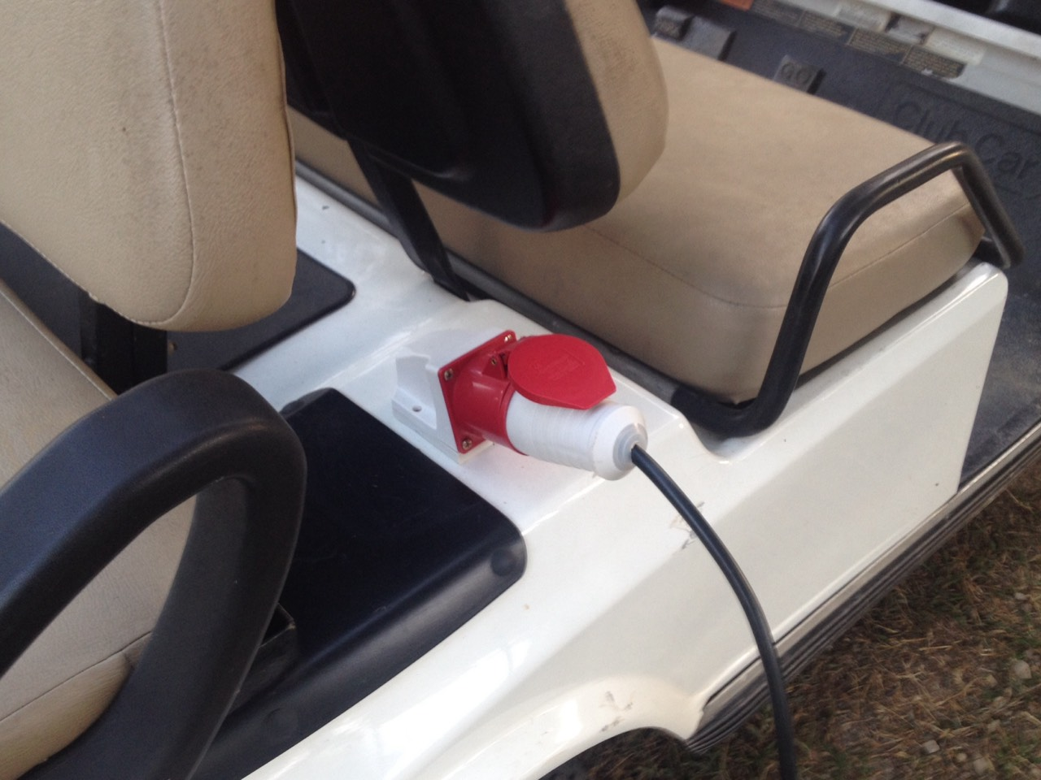
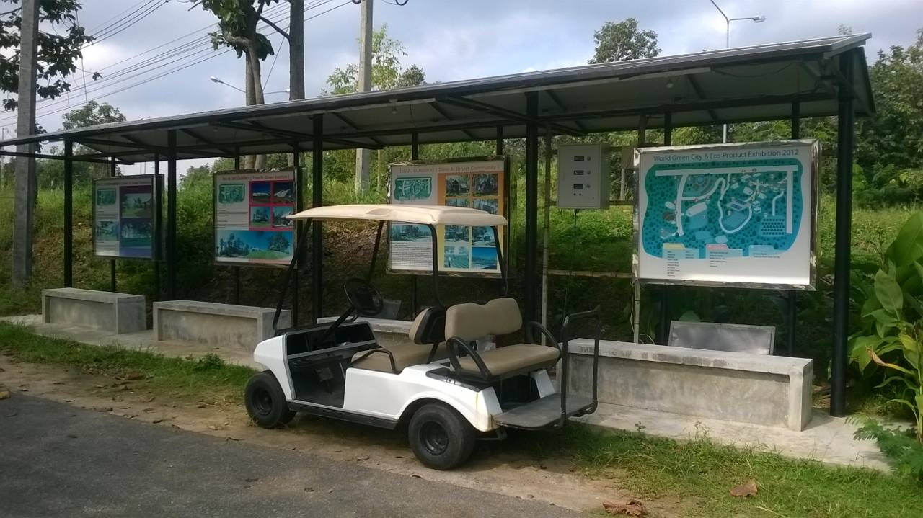
EV
Solar Bus Stop
EV Charging Station
Motorbike Charging Station
Energy Storage
T. Jaorum - Intern
W. Luangpraditkul - Researcher
Solar Bus Stop
Notes:
We have road. We also have electric vehicle. Our student develop the charging system and make the bus stop with Solar Cells and battery stored down at the benches.

Slide 44
Home/Building Cycle → Energy efficient – Natural Material
EPS Foam Energy Efficient House
Notes:
This house is from EPS foam. All the interior is made out of foam as well.

Slide 45
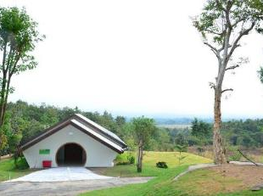
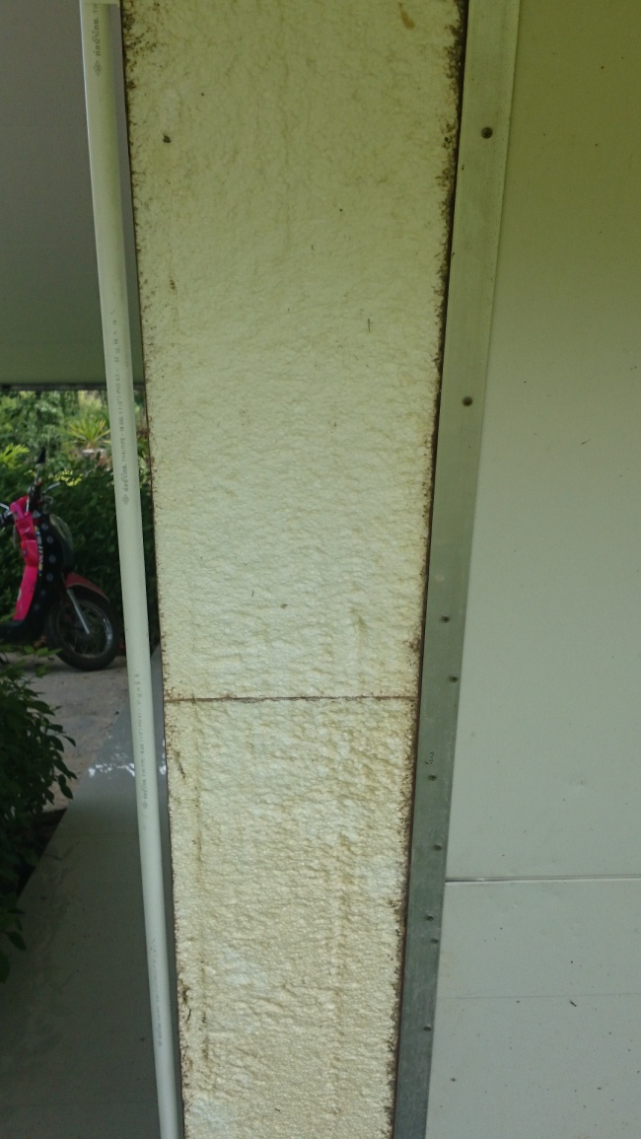
Energy Efficient Conference Room
Expanded Polystyrene (EPS) FOAM

Slide 46
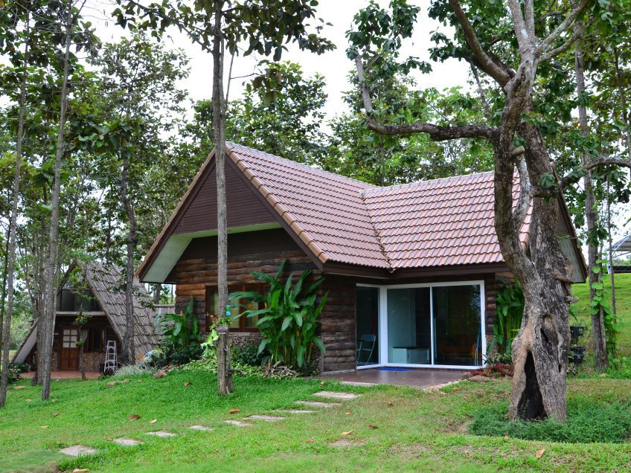
Residence
Notes:
Different style of housing from traditional house to low cost housing to expensive energy efficient housing.

Slide 47
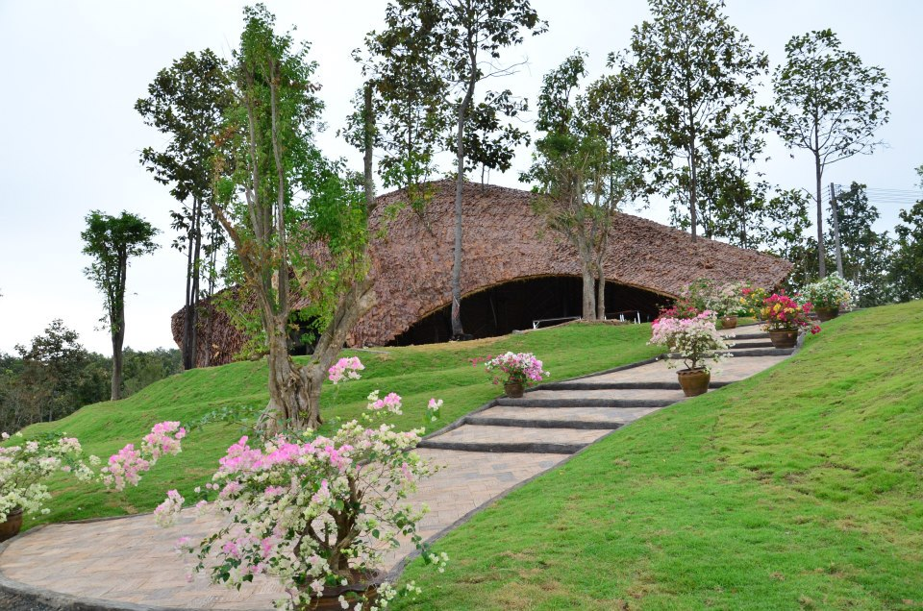
Natural Material Conference Room
Notes:
The design of the Turtle back conference hall emphasize on the the use of natural material. The usage of leaves as the roof is conventional in the rural area and we apply it in a modern style. The location of the conference hall has good wind flow which create a comfortable atmosphere all day long.

Slide 48
Reuse material house

Slide 49
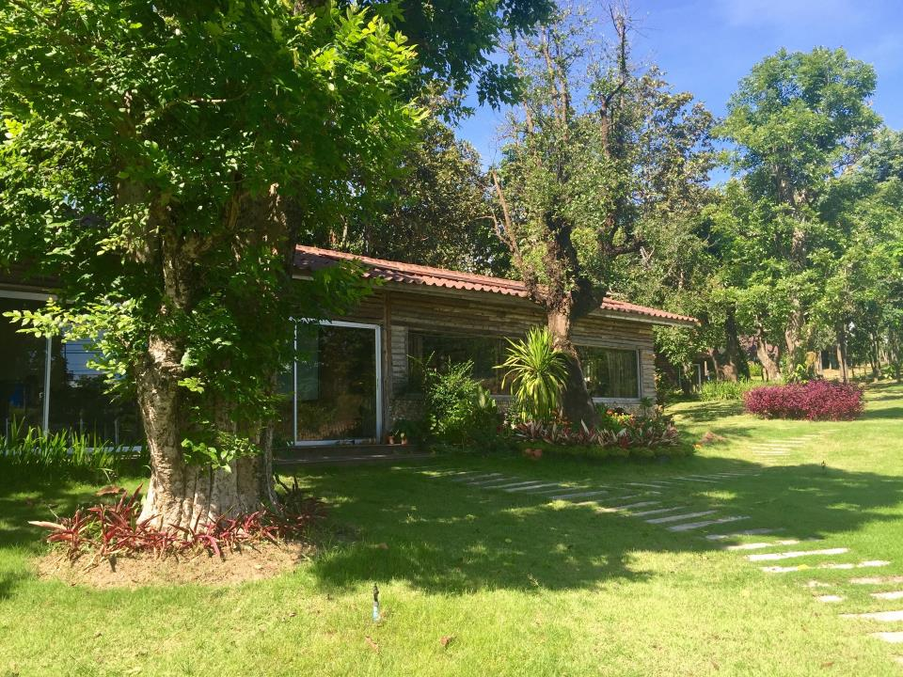
Office

Slide 50
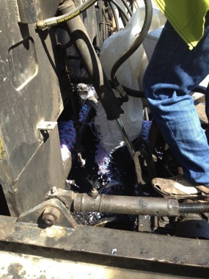
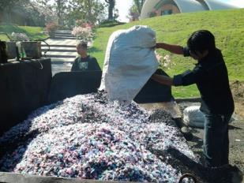
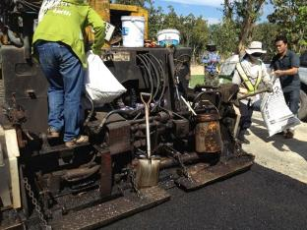
Waste Plastic Road

Slide 51
Chiang Mai World Green City Carbon Emissions
The CO₂ cycle assessment of CWGC model was employed to establish a green city master plan and operational plan for low carbon society at adiCET. adiCET aims to be the first practical carbon neutral community in Thailand.
X₁ Green Area
X₂ Renewable Energy
Chiang Mai World Green City
Goal – Low Carbon Society
X₃ Green Building
X₀ Emission from Construction
CO₂ Sequestrations
CO₂ Emissions
X₄ Energy saving from Lighting
X₇ Electricity Consumption
X₅ Reduce Reuse Recycle
X₈ Waste, Water, Fuel
X₆ Smart Transportation
X₉ Transportation
Driving Variables (N) Population | Constant Variable (X₀) Emission from the beginning of construction | Sequestration Group (X₁-X₆) | Emission Group (X₇-X₉)
adiCET staff with permanent resident adiCET staff with non-permanent resident Student Visitors | X₀₁ Loss of tree from developed land X₀₂ Cut and fill jobs from land development X₀₃ Carbon footprint building 16 units X₀₄ Emission of asphalt road | X₁ CO₂ intake from green area X₂ Electricity production from PV and Gasifier X₃ Energy saving from green design building X₄ Energy saving from lighting system X₅ Environment management X_{5W} 3R₃ project of plastic and organic waste X_{5H} 3R₃ project of water X_{5C} Bio-Char project X₆ Smart transportation | X₇ Electricity Consumption X₈ Emission from waste, water used and fuel X₉ Emission from Transportation
Variables kgCO₂e
X₀₁ 62,065
X₀₂ 51,888
X₀₃ 63,199
X₀₄ 54,795
Total 231,947

Slide 52
Business as Usual/ Ideal Condition
The net accumulated Carbon : 2,001,834 KgCO₂
Carbon Credit : -979,897 THB
(Ref : 489.5 THB/T/CO₂: 2554)
Ideal condition
No activity of CO₂ Mitigation (BAU)
No use of Renewable Energy
No change in energy efficient device
No recycling and waste management
Inefficient transportation
Excess energy usage
Green Activity
Green Space, Tree planting
Renewable Energy usage
Efficient Lighting/ No. 5 Devices
Waste management and biomass usage
Water management
Energy efficient transportation and biofuel

Slide 53
Issues to Overcome
System Issues
During the rain, the voltage fluctuates from the utility line which cause the Hybrid Microgrid system to be disrupted.
The old power meter in the smart community causes damage to the power monitoring unit during the voltage fluctuations.
The university change the IP address and this causes failed data recorder. The online connectivity is still a problem.
When using AC as backup power, there are some back flow of current.
The capacitor was damaged when AC was used over the voltage setting.
Explore voltage range for Diesel Generator
Nature Issues
Human Issues

Slide 56
Conclusion
The direct current PV system is able to supply sufficient power to each house in the Smart Community
There were a lot of system on-site trouble shooting do to nature and behavior of user
Notes:
The low voltage direct current system was used to supply direct-DC power to modified household appliances include LED lighting, refrigerator, air conditioner, television and electric water heater. The results indicated that the power consumption from the modified appliances is lower when DC power was used in comparison to AC power. The highest energy savings was LED lighting with 38%. However, with high power rating appliances, there are no significant difference for the energy savings between DC and AC usage. The power consumption profiles for the appliances are quite stable indicating the DC power quality. As a result, for the rural community application, the household appliances can be modified with simple and affordable techniques to comply with DC power. The modified appliances can be used efficiently with solar home systems or community decentralized PV systems with direct-DC distribution.

Slide 57
Acknowledgments
NICOP Grant from the Office of Naval Research, USA
Ministry of Energy, Thailand
National Research Council of Thailand
Chiang Mai Rajabhat University
Uttaradit Rajabhat University
ASEAN – U.S. Science and Technology Fellowship

Slide 58
Thank You
Contacts:
Website: www.adicet.cmru.ac.th Email: hathaithip.nin@gmail.com
Facebook: www.facebook.com/adicetfan Phone: +6653-885871

